Slide 1
Automatic electrostatic discharge tester.
Viktor Hugo Hersom From

Slide 2
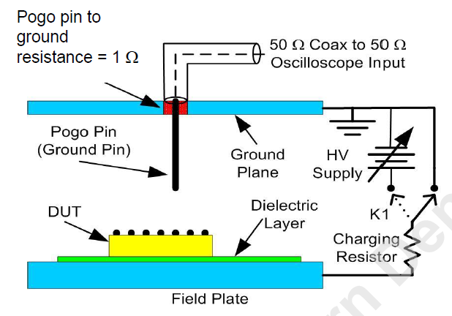
What is the problem?
Electrostatic discharge (ESD) events.
39 – 48% of all product failures in industry related to ESD.
JS-002-2018 test standard.
Used to measure discharge from a device.
Time-consuming to complete.
The most important parts are:
Pogo pin
Ground plane.
Device Under Test (DUT)
Oscilloscope
Notes:
Electrostatic discharge is a phenomenom, where a voltage potential is built up across two or more components that are insulated from each other.
These voltages can be strong enough to cause a breakdown of the material between them, forming a conductive path.
When that happens, the voltages will be discharged. These voltages can be strong wnough to damage the components.
Indeed, an estimated 39 – 48% of all product failures in industry are caused by some form of electrostatic discharge.
While the discharges caused by a human worker on a component are well understood and covered by the Human Body Model, the corresponding discharges caused by components discharging on each other are not so well understood.. Ergo, it is necessary to test the component by following a very specific test procedure.
In this test, the component to be tested on is placed on a dieletric layer and charged through a field plate to a specified voltage.
A pogo pin is then connected to a ground plate and brought in contact with all exposed metal parts of the component.
When that happens, a discharge will occur.
This discharge is then measured by an oscilloscope connected to the whole setup and the waveform of the discharge is stored for later analysis.

Slide 3
What is electrostatic discharge?
Triboelectrification.
Electrons are transferred between materials when there is contact.
Charges build up on the two materials.
Electrostatic discharge.
The material between the two charges breaks down.
A conducting path is formed.
Charges move from one component to another.
Notes:
What exactly is electrostatic discharge?
Electrostatic discharge is a phenomenom that happens when two charges, separated by an insulating material, have become strong enough to cause a breakdown of the material between them. This forms a connecting path between the two components, where charge can move along it.
The actual buildup of charge happens due to a process called triboelectrification.
Triboelectrification is when electrons are transferred between two materials, that are in contact with each other.

Slide 4
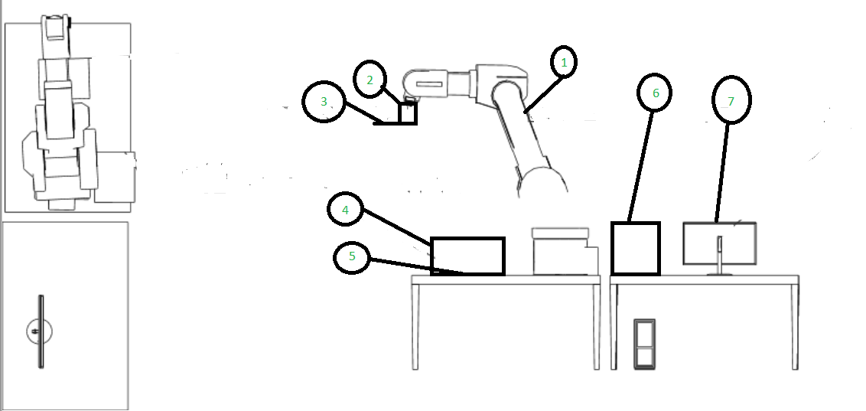
The concept.
A Kawasaki robot arm
A holder consisting of three parts:
Robot tool strut.
Ground plate.
Sensor mount.
A distance sensor and a camera.
A box designed to eliminate shadows.
The Device Under Test (DUT)
An oscilloscope.
A computer used to control everything.

Slide 5
The holder.
The holder is designed to accommodate:
A ground plate.
10 1-ohm resistors.
A pogo pin.
A distance sensor and camera.
The holder consists of three parts:
A robot tool strut.
A ground plate.
A sensor mount.

Slide 6
Hardware.
See3 Cam 130.
VL53L4CD distance sensor.
Force-sensitive resistor.
Oscilloscope.

Slide 7
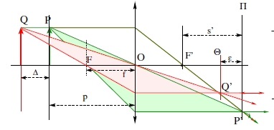
See3 Cam 130
Requirements:
Must be USB – or I^2C – enabled.
Must have a resolution of at least 640x480 pixels.
How does it work?
Image P’ is formed of object P on plane II
CMOS sensor captures the image.
Notes:
How is an image created?
What is shown here is the principles of image formation.
Light coming from an object at a point P passes through a lens centered on a point O and is focused on a point F’, known as the focal point.
As long as the image plane II is behind the focal point, an image P’ is then formed. This image can be captured by the use of either photographic film or an image sensor.
If the object at point P is moved to a new point Q, the corresponding image is now no longer formed on the image plane II, but on a new image plane theta.
This image is captured by the use of a CMOS sensor.
CMOS stands for Complementary Metal-Oxide Semiconductor.
The semiconductor material most used today is silicon.
This is because silicon is a semiconductor and can be used as a diode.

Slide 8
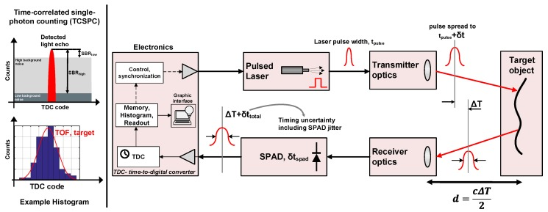
VL53L4CD distance sensor.
Requirements:
Accuracy < 2 mm.
How does it work?
Laser sends out signal.
Signal is encoded.
When signal is sent out, a timer is started
Signal is reflected by target.
Timer is stopped, when signal returns.
L = c/2*T_TOF
Notes:
For the distance sensor, the VL53L4CD distance sensor is chosen, based on the requirement that the accuracy of the measurement should be less than 2 mm.
It works in the following way:
Laser sends out a signal.
This signal is then encoded.
When the signal is sent out, a timer is started.
The signal then is reflected off of a target.
The timer is stopped, when the signal returns.
The distance can then be calculated as L = c/2*T_TOF

Slide 9
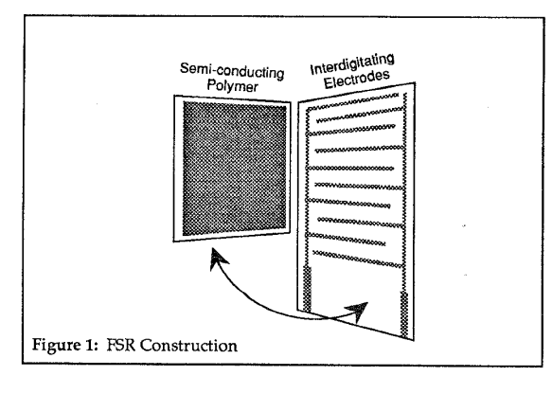
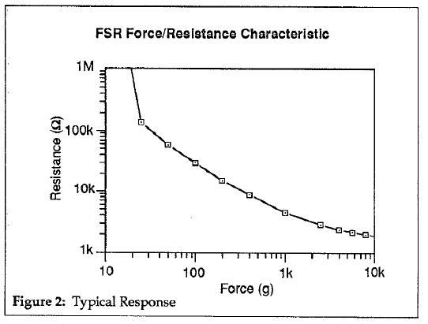
Force-sensitive resistor.
Requirements:
Minimum force measured: 1 N.
Maximum force measured: 70 N.
Not ESD-sensitive.
How does it work?
Two polymer films.
Thin sheet of ”fingers” on the bottom layer.
As ”fingers” are stretched, their resistance decreases.
Notes:
A force-sensitive resistor consists of a series of metallic ”fingers” deposited on a polymer film.
As force is applied to the ”finegrs”, their resistance decreases.
This drop in resistance

Slide 10
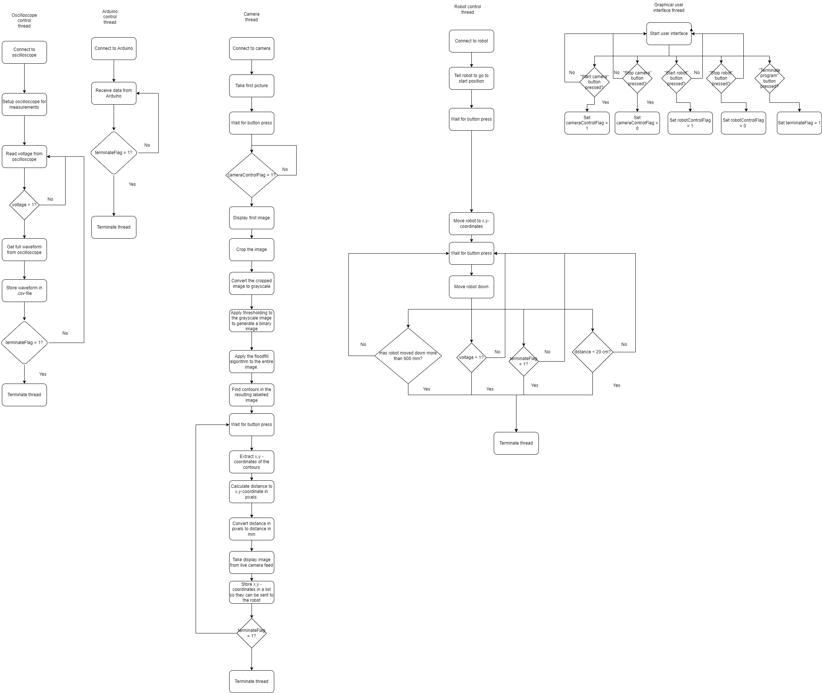
The software concept.
Five threads:
Oscilloscope.
Arduino.
Robot control.
Video.
Interface.
The most important threads are:
Video
Robot control
Notes:
In order to make the program fail-safe, it has been split up into five separate threads.
This is to ensure that if any one of them fails, it will not affect the other threads.
Each thread is assigned one specific responsibility:
Oscilloscope.
Arduino.
Robot control.
Video.
Interface.
The most important threads are:
Video.
Robot control.

Slide 11
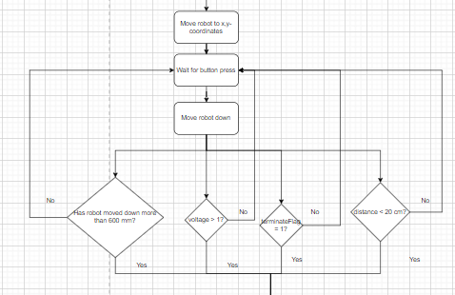
Robot control
Steps:
Move robot to x,y-coordinates.
Wait for button press.
Move robot down.
Stop the robot if:
Robot has moved down more than 600 mm.
The measured voltage is above 1 V.
TerminateFlag is set to 1.
The measured distance is below 20 mm.
Notes:
The robot control thread has to go through several steps:
Move robot to x,y – coordinates. The x,y – coordinates are determined by the Video-thread.
Wait for button press.
Move robot down.
Stop the robot if:
Robot has moved down more than 600 mm.
The measured voltage is above 1 V.

Slide 12
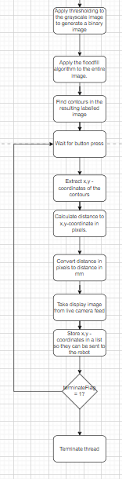
Video thread
Steps:
Generate a binary image.
Apply floodfill.
Find contours in the resulting image.
Wait for button input.
Extract x,y – coordinates.
Calculate distance to coordinates.
Convert distance to mm.
Send distance to robot.
Notes:
The Video thread is responsible for determining the position of a target.
To do this, it is necessary to go through several different steps:
First, the thread has to generate a binary image.
Following this, the floodfill algorithm can be applied to segment the image.
After this, the contours can be found in the resulting image.
Then, the x,y coordinates can be found for the contours and the distance from the center of the image can be found.

Slide 13
Different concepts for the solution.
CamDist
Sphereo
Stereo image method.
Imaging and ranging combined.
Notes:
For the solution, obviously, several different design concepts were considered.
The most important ones I want to mention here are:
CamDist.
Sphereo.
Stereo image method.
Imaging and ranging combined.

Slide 14
CamDist
Two pictures:
One picture taken at first.
Camera moves a set distance forward.
Second picture is taken.
Difference between the images gives the distance to the object.
Notes:
CamDist is a method developed to determine the distance to an object using a single camera.
The basic idea is that you take one picture and locate an object within it
Then, you move the camera forward a set distance and take a second picture
Based on the difference in scale of the of the object, you can then determine the distance to it.

Slide 15
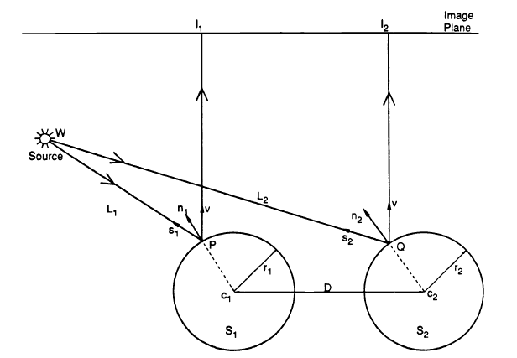
Sphereo
Two balls used to generate two images.
Two balls separated by a known distance D.
Reflection forms two separate images.
Triangulation performed on the two images to generate a 3D-map.
Figure source: Shree K. Nayar, "Sphereo: Determining Depth Using Two Specular Spheres And A Single Camera," Proc. SPIE 1005, Optics, Illumination, and Image
Sensing for Machine Vision III, (7 March 1989); doi: 10.1117/12.949051
Notes:
Sphereo is a different method for determining the distance to an object.
It works by having two highly reflective balls placed a known distance D from each other, with a camera placed above them.
These two balls form a reflected image of the object and by taking a picture of the two balls and splitting the image into two images.
By then correcting the two images, you end up with two distinct images that can be used to build a 3D-map of the component.
This can be done through triangulation.

Slide 16
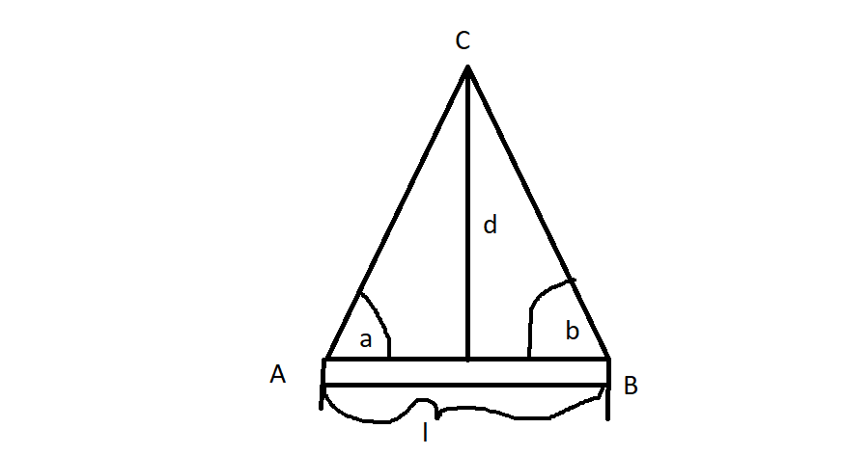
Triangulation.
Given:
Point A.
Point B.
Angle at point A.
Angle at point B.
Distance between points A and B
Find:
Distance to point C.
Method:
tan(a) = d/(l/2)
Find the angle a = tan^-1(d/(l/2))
Notes:
Triangulation works in the way that if you have two points A and B, separated by a known distance L, then you can find the distance to a third point C by the use of trigonometry.
The method works in the following way:

Slide 17
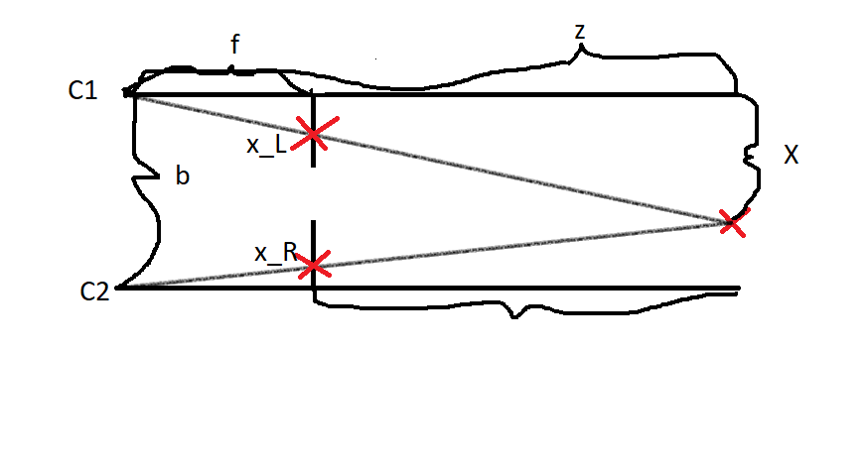
Triangulation (continued)
Given a point on an image plane, it is then possible to determine the angle from the camera to the point on the image plane.
X_L/f = x/z ⬄ x_L = x/z*f
X_R/f = (x-b)/z ⬄ x_R = (x-b)/z*f
Disparity = X_L – X_R = (f*b)/z
Z = (f*b)/d
Notes:
In triangulation, the first step is to detect the same object in the two different images.
Based on this, it is possible to get the disparity between the two image points by finding the difference between them.
The point on the image plane, together with the focal length of the camera, then forms a triangle. This triangle is a similar triangle to the one formed by the distance from the optical center of the camera to the actual point x.
Because of this, the ratio between the two sides of each triangle are equal to each other and hence the pixel coordinates can be expressed as x_L/f
.

Slide 18
Stereoscopic imaging.
Using the difference between two images to determine depth of a scene.
Fundamental matrix F.
Essential matrix E.
Rotation matrix R.
Rectified images.

Slide 19
Imaging and ranging combined
One camera used in combination with a range-finding sensor to determine position and range.
Methods for ranging:
LiDAR.
RADAR.

Slide 20
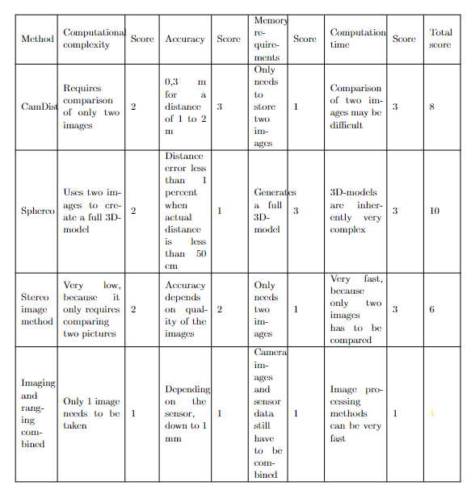
Comparison of the different methods
Criteria:
Computational complexity.
Accuracy.
Memory requirements.
Computation time.
Notes:
In order to choose between the different approaches, I set up a number of criteria for selecting the best approach.
These criteria are:
Computational complexity.
This is based on the knowledge that the more complex the computations are, the more time the computer has to spend on them.
This is given a rating on a scale from 1 – 5, where 1 is the best and 5 is the worst. It is based on the number of pictures needed for each method to work.
picture: 1.
Pictures: 2.
Pictures: 3.
Pictures: 4.
5 pictures or more: 5.
Accuracy. One of the stated requirements for this project is that the measurement of the distance to the object should be less than 2 mm.
Less than 2 mm: 1.
Between 2 and 3 mm: 2.
Between 3 and 4 mm: 3.
Between 4 and 5 mm: 4.
5 mm or above: 5.
Memory requirements: None of the methods considered have a stated minimum memory need. Hence, the assessment of this criteria is more an evaluation than anything else.
Very low: 1.
Low: 2.
Medium: 3.
High: 4.
Very high: 5.
Computation time:
Less than 10 ns: 1.
Less than 100 ns: 2.
Less than 200 ns: 3.
Less than 300 ns: 4.
300 ns or above: 5.
As you can see, because the method Imaging and ranging combined only requires one picture being taken and uses a sensor to measure the distance, it scores the lowest and is therefore the best method. Hence, it is chosen as the method to use.

Slide 21
Image processing
Grayscale.
Thresholding.
Finding contours.
Finding x,y-coordinates.
Notes:
Imaging and ranging combined relies on the use of image processing.
For the image processing, there are several steps that has to be completed before any useful information can be extracted from the image.
This includes converting the image to a grayscale image, applying thresholding, finding contours and finding the x,y-coordinates of the component that is discovered.

Slide 22
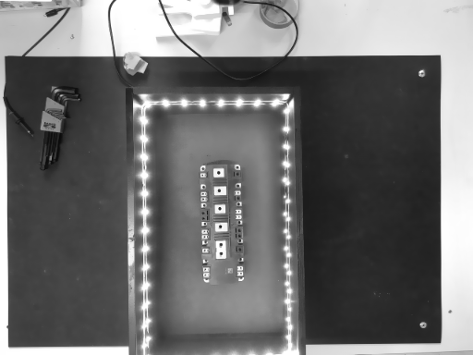
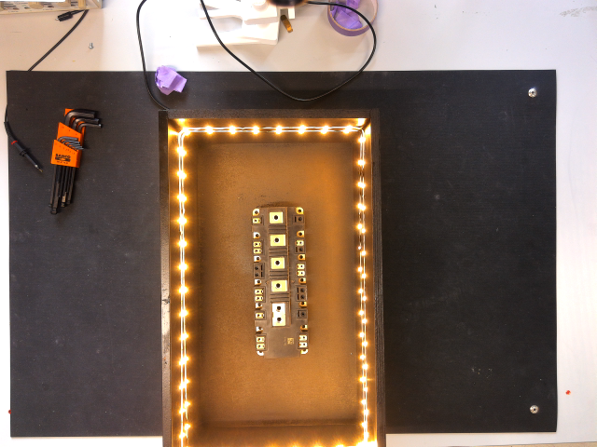
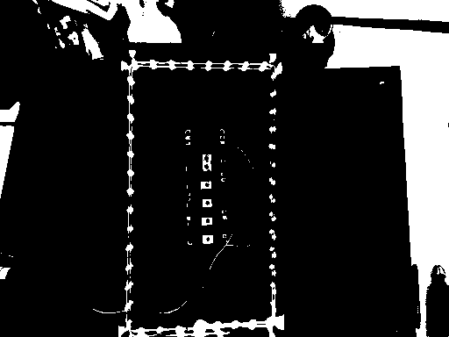

Image processing theory.
Grayscale:
Combine the three color channels into one channel.
Value then represents the intensity of light.
Thresholding:
Convert the grayscale image into a binary image.
If intensity is above a threshold value: 255.
If intensity is below a threshold value: 0.
Finding contours:
findContours()-function from OpenCV.
Extracting x,y-coordinates:
The boxPoints()-function from OpenCV.
Notes:
Converting an image to grayscale means combining the three colour channels of a full-colour image and combining them into one channel.
Each channel is an 8-bit integer and the resulting value will therefore also be an 8-bit integer. This value then represents the intensity of light for that given pixel.
This value be any whole number in the range 0 – 255.

Slide 23
Image segmentation
Possible methods:
Watershed.
K-means segmentation.
Color segmentation.
Contour segmentation.
Template matching.
Floodfill.
Notes:
Image segmentation means to split the image into separate regions, that can then be analysed or manipulated according to the needs of the project.
There are several methods available for segmenting an image:
Watershed segmentation.
K – means segmentation.
Color segmentation.
Contour segmentation.
Template matching.
Floodfill.

Slide 24

Watershed
Topographical map of the intensity.
Peaks and valleys.
Valleys are filled up.
Conflicts between labels give borders.
Notes:
Watershed segmentation relies on the knowledge that a grayscale image can be converted into a topographical map, or ”height map” where the height is the intensity of light at each pixel.
This map will then have a series of maxima (peaks) and minima (valleys).
For each valley, it is then possible to assign the same label to all pixels within that valley. That valley is then considered as a separate region.
This can be done for each valley, where there are unmarked pixels.
When there’s a conflict between two labels, the pixel where the conflict happens is given the label -1 and is considered a border between the two regions.

Slide 25

K-means segmentation
Pixels are sorted according to their values.
Each group of pixels gets a separate label.
Notes:
K-means segmentation relies on the assumption that all pixels belonging to one object will have a similar value in intensity. Therefore, if they are grouped together according to their value, each group of pixels can be assigned the same label.
K-means

Slide 26
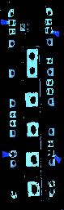
Color segmentation
The image is converted to HSV color space.
Hue.
Saturation.
Value.
Target has color within a certain range.
Image can then be split into ranges.
Notes:
Color segmentation relies on the fact that instead of grouping the pixels according to their intensity, the entire image can be split into regions according to the color.

Slide 27

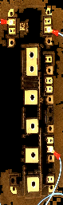
Contour segmentation
Convert to grayscale.
Canny edge detection.
Second derivative of the gradient between pixels.
Find the zero crossing.
Collect the contours in a list.
OpenCV findContours().
Looks for connected components in the binary image.
Generate a mask based on the contours.
Apply the mask to the original image.
Notes:
Contour segmentation relies on the fact that any clearly defined object within an image will have clearly defined edges on the resulting grayscale image.
These edges can then be found by applying a Canny edge detector to the grayscale image.
The Canny edge detector calculates the second derivative of the gradient between the pixels and the finds the zero crossing of the second derivative. This is because the second derivative is the rate of change of the gradient. The rate of change will always be zero for any pixel, where there is an edge.
Based on the found edges, a mask can then generated that can be applied to the original image

Slide 28
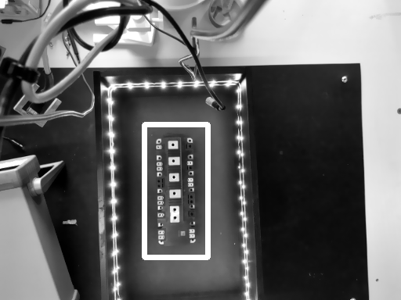
Template matching.
Two images:
New image.
Template image.
Matches obtained by minimizing the maximum likelihood function: Li,j = ( 1/√2πσ )^n ∗ e^(− 1/ 2 ∗∑x,y ( (Ix+i,y+i−Tx,y)/σ)^2
min(e) = ∑x,y(Ix+i,y+j − Tx,y)^2
Notes:
Template matching means that given a template image and an original image, it is possible to find the region of the original image most closely resembling the template image.
This is done by minimizing the maximum likelihood function between each of the pixels.
In order to make the calculation easier, usually, the natural logarithm of the function is taken and minimized.
When this is done, the result is minimizing the squared difference between the pixels.

Slide 29
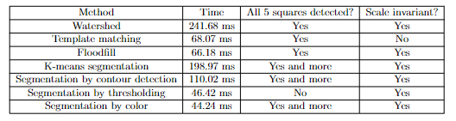
Comparison of the different methods
Notes:
In order to select the best method, I have set up a number of criteria for selection.:
Time
All 5 squares detected?
Scale invariance.

Slide 30

Floodfill.
How does it work?
Finding a seed point.
Visit the neighbouring pixels.
Mark them if they are unmarked.
When two neighbouring regions meet:
Note the conflict.
After the entire picture has been marked, resolve the conflict.
Notes:
The basic assumption for this algorithm is that the image can be split up into background pixels and foreground pixels. This is true for binary images, because in a binary image, any black pixels can be considered as the background and any white pixels can be considered as the foreground.
The method works by first finding any pixels in the foreground that has not been assigned a label yet.
It assigns it a label and then visits its neighbours. These neighbours are found by applying a kernel to the image. This kernel can be either 4 – connected or 8 – connected.
Any unmarked foreground pixels within that kernel are then assigned the same label.
However, if one of them already has a label, then the conflict is stored in a separate list and resolved after the entire image has been labeled.
The way it is resolved is by choosing the lower of the conflicting labels and continuing to do this until all conflicts have been resolved.

Slide 31
Experimental results.
Force-sensitive resistor.
Distance sensor.
Oscilloscope.
Notes:
Now, I am going to go through the experimental results for the:
Force-sensitive resistor.
Distance sensor.
Oscilloscope.

Slide 32
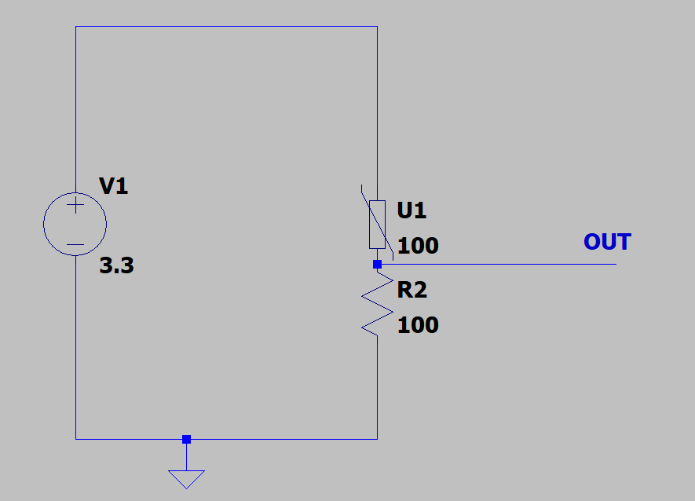
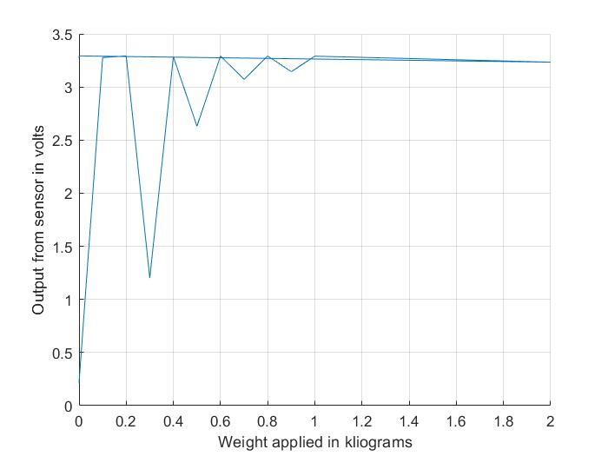
Test of force-sensitive resistor
Notes:
What you see here is the output voltage from the force-sensitive resistor for a weight ranging from 0 kg to 2 kg.
This is equivalent to a force ranging from 0 to 10 N.
The resistor is set up in a voltage divider and is represented here
What is important to note here is that the voltage increases in a manner inversely proportional to the resistance.
This proves that the resistor can be used to sense a force ranging from 0 to 10 N.

Slide 33
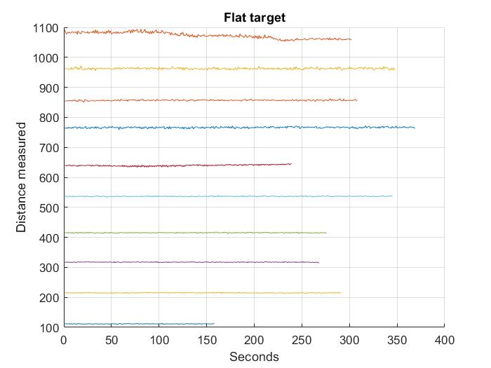
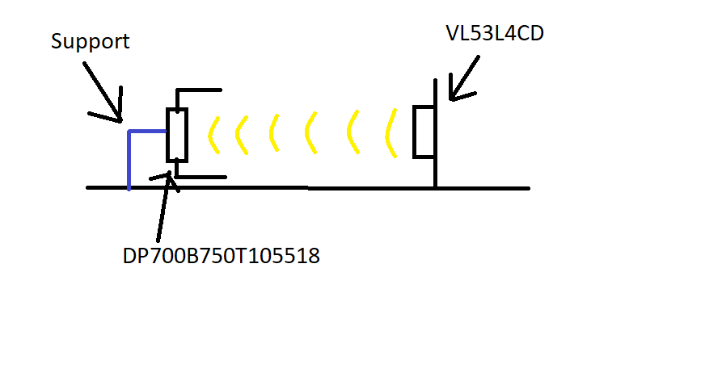
Test of VL53L4CD distance sensor.
Notes:
What you see here are the results for the VL53L4CD distance sensor.
As can be seen in

Slide 34
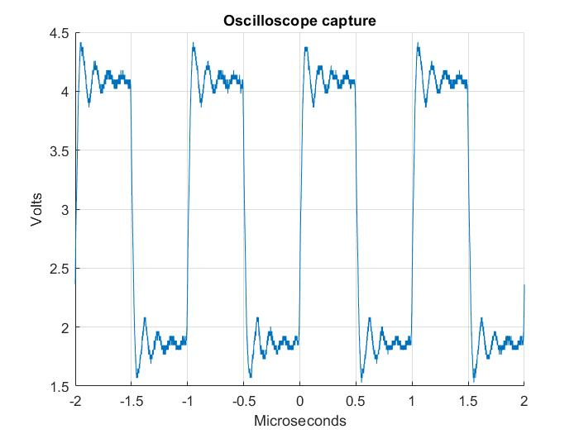
Test of oscilloscope capture.
Notes:
What you see here is the result of the test of the oscilloscope capture.

Slide 35
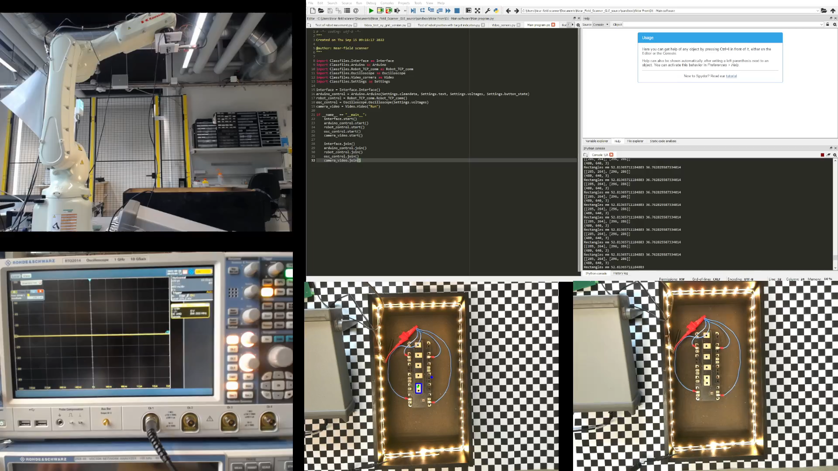
Acceptance test
Notes:
This is the acceptance test for the setup.
In order for the setup to pass the acceptance test, the setup needs to be capable of:
Correctly identifying at least one test point.
Moving the probe to the test point.
Taking one measurement from the test point..

Slide 36
Conclusion.
Design allows for one measurement to be taken on a charged unit.
Mechanical design consists of three parts:
Robot tool strut.
Ground plate.
Sensor mount.
Software design consists of:
Floodfill.

